Slide 1
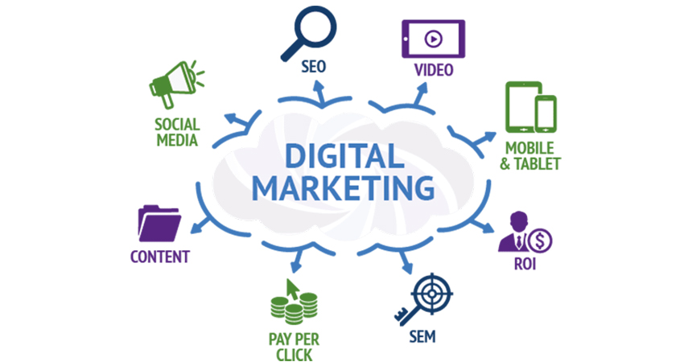
Project 2: Market your content
Laavanya Ganesh
THE ONLY FASHION THAT NEVER DIES

Slide 2
GUIDELINES FOR THE PROJECT
Step 1
Marketing Objective, Primary KPI, Target Persona for Blog post
Step 2
Choose the topic for Blog Post, SCQA/Pixar Framework, Write Blog Post
Step 3
Craft Social Media Posts on 3 Social Media Platforms
Step 4
Extra Credit Analysis

Slide 3
MARKERING OBJECTIVE & PRIMARY KPI
MARKETING OBJECTIVE: To gain a minimum of 50 reads on the blog post by March 2019 by tracking audience engagements like Facebook likes, Twitter tweets and Medium applauses
PRIMARY KPI: Number of reads for the blog post

Slide 4
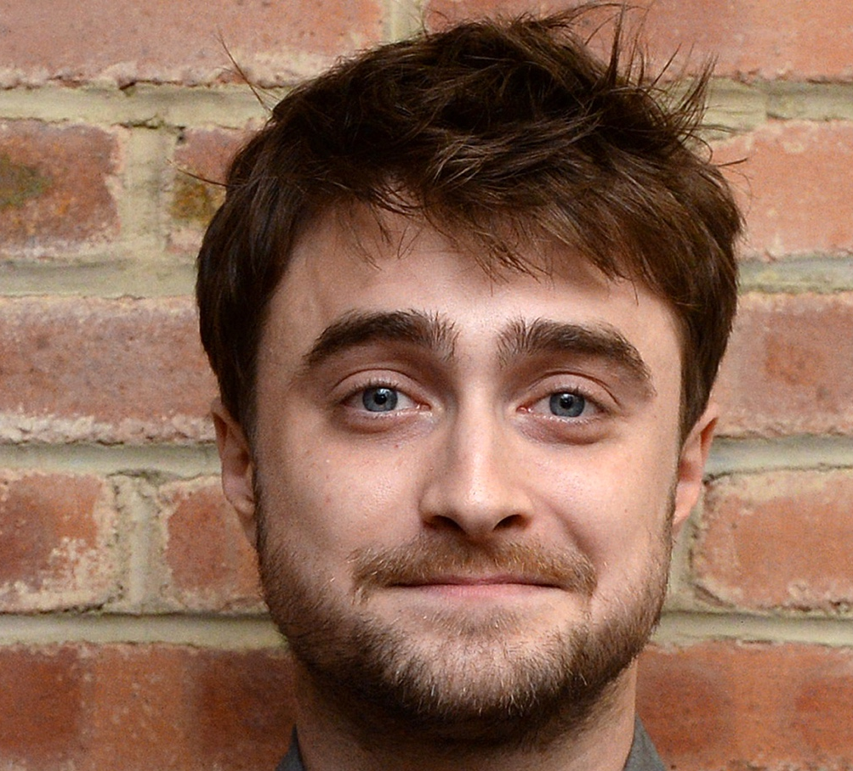
Target Persona
Background
Age: 26 years old
Education: Bachelor’s Degree
Location: California, USA
Job Title: Analyst
Email: Daniel2093@gmail.com
Annual Income: 500000 USD
Needs
Better Work/Life Balance
Growth in a Big Company
Love what I do
Become more technical
Balance between career expectations and family
Being my own boss
Educational content that provides: Quality and environmental friendliness
Target Persona
Daniel Krum
Free Time Activities
Watching movies and TV with friends
Sailing
Reading marketing/digital marketing articles
Biking Traveling
Cooking and baking
Reading, Writing
Spending time outside - swimming, kayaking, snow shoeing
Enjoy live music and travel
Hang out with kids and play basketball
Goals
To be a great marketer
Build something impactful
Want to be the owner of my life
Growth in current role
Would like to be an entrepreneur managing digital marketing for businesses, and have a successful drop shipping business.
Want to be working remotely as a Social Media Marketer/Manager or want to be running my own Affiliate Marketing brand/business
Professionally, want to be working remotely as a Social Media Marketer/Manager or want to be running my own Affiliate Marketing brand/business
To have a remote job as a digital marketer by March 2019. To travel to all 50 states by December 2019
More passion focused
Barriers
Travel time to work
From a small town, lack of marketing opportunity here outside of being a freelancer
Lack of time
Obtaining a degree that doesn't help get the jobs
Work Over 40 Hours Weekly
Price of Nanodegree programs
Mental barriers, hesitation
Lacking skills to do the job

Slide 5
TOPIC FOR BLOG POST
Choose A Successful Or Creative Marketing Campaign That You Love.
What Is The Story Being Told By The Campaign And Why Do You Love It
Why Did It Catch Your Attention?

Slide 6
SCQA Framework
SITUATION: Daniel aspires to be a Media Marketer running his own affiliate marketing brand
COMPLICATION:
He fears lack of time and skills might hinder his efforts to achieve his goal. He wants more of quality educational content for example various content marketing campaigns that could enhance his ken of knowledge regarding the same. There are lots of informational content available online and oﬄine, so much so that it gets overwhelming to ﬁnd the right suited for him
QUESTION:. Where can he find the best resource that suits his needs?
ANSWER: LinkedIn’s video marketing campaign elucidated him more on ways videos could help him promote his content online

Slide 7
BLOG POST ON MEDIUM
This blog post is a storytelling in Daniel’s words of how LinkedIn’s video marketing campaign aided in getting him a broader perspective of how content marketing through videos has an impact on the target audience. It’s a storytelling of Daniel, before and after he came across LinkedIn’s video marketing campaign in 2018.
This is the link to the Google Docs that contains the blog post, since I haven’t published the post
https://bit.ly/2HD60hg

Slide 8



Social media platforms for target audience
The diversified social network helps to create awareness about the blog by tracking audience engagement such as likes, comments, shares etc. It also gives a platform to roll the dice on people who probably aren’t in my audience list yet by placing ads to promote my blog post
The economic professional graph of LinkedIn with 1st ,2nd ,3rd degree connections helps me to expand the reach for the blog post and at the same time aids in creating an online professional presence through the post
It is the best possible platform to take my blog post to a wider audience through its ‘re-tweet’ feature thereby giving an opportunity to grow my targeting list with high quality leads

Slide 9
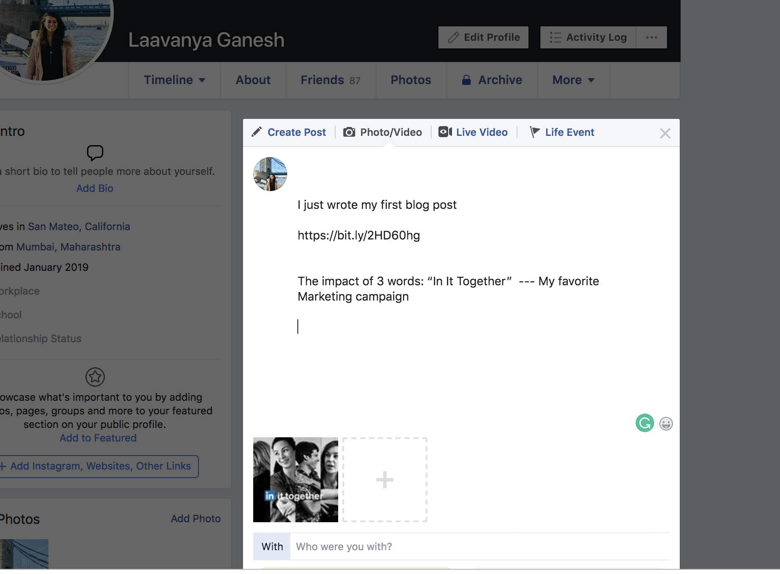
FACEBOOK POST
Just to illustrate
that I am aware of the way
to create a Facebook post

Slide 10
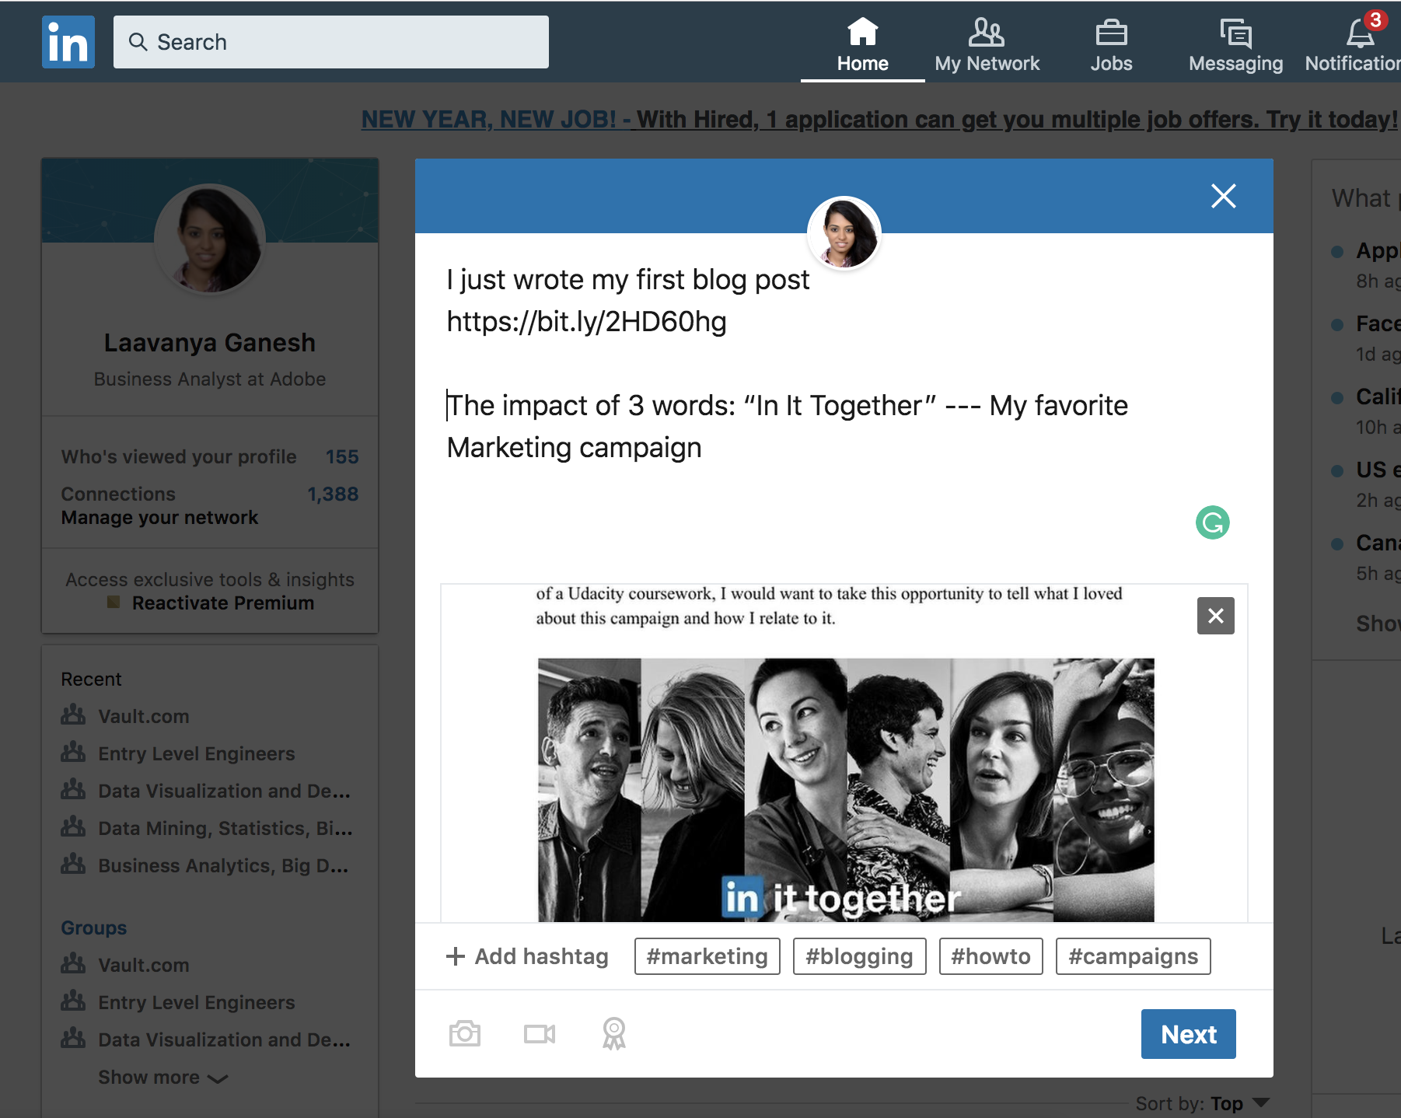
LINKEDIN POST
Just to illustrate
that I am aware of the way
to create a LinkedIn post

Slide 11
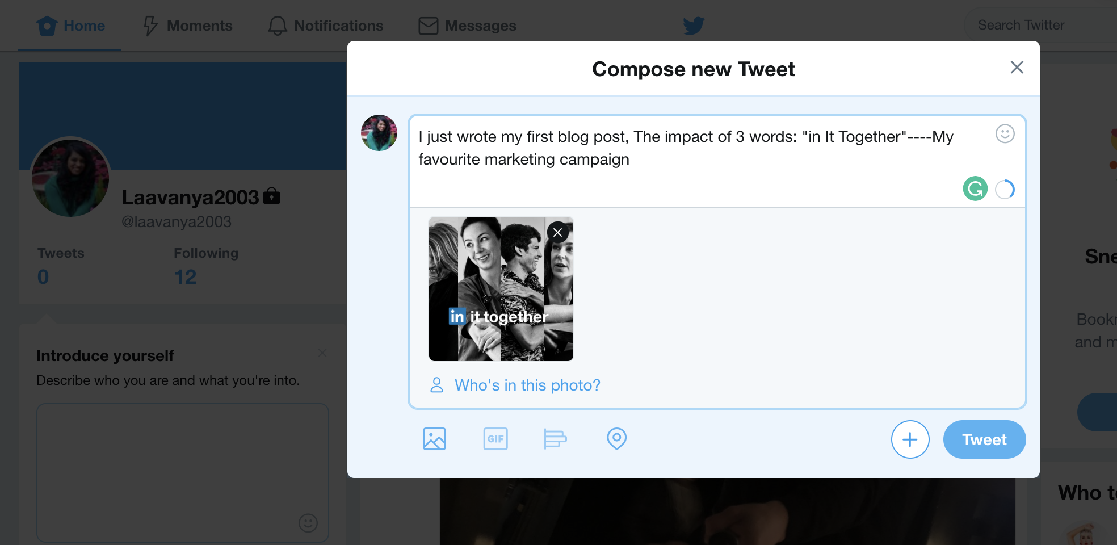
TWITTER POST
Just to illustrate
that I am aware of the way
to create a Twitter post

